Slide 1
Strictly Drinking CORS with JSON
Clark Sell
Microsoft

Slide 2

name: ‘Clark Sell’
30 something, married w/ 2 little tax deductions
http://ClarkSell.info
@csell5
Live between CHI and MKE
Web Developer
Web Evangelist, Microsoft

Slide 3


Slide 4


Slide 5


Slide 6


Slide 7

Notes:
Why talk about JavaScript?
We already know it’s the language of the web. Over the past couple of years, JavaScript has made a huge cool kid resurgence in the web space.
-----
Image taken from: http://www.flickr.com/photos/alshepmcr/4298593016/sizes/l/in/photostream/

Slide 8

Notes:
JavaScript is a big deal, not just some toy. Just because it has the word script in the name doesn’t somehow make it inferior to other languages. In fact it’s quite the opposite.
It controls the interactions, validations, the sites overall behavior.
It makes our site POP!
-----
Image take from: http://www.flickr.com/photos/qwrrty/149827235/sizes/o/in/photostream/

Slide 9

Notes:
JavaScript was a language where majority of web developers just dealt with, to a language where people are now super passionate and treat it like a first class citizen.
Why, what happened?
Was it jQuery?
Was it the release of new standards like HTML5 or EcmaScript 5?
Was all the new devices?
I don’t think there is just one answer, but rather a columniation of many factors.

Slide 10









Notes:
One of those factors of course being HTML5.
HTML5 is clearly here to change the world of markup. And while some of it, are things we’ve been waiting a long time for, others features are pretty progressive thinking, like web sockets, and storage.
But were talking about JavaScript,
With HTML5 starting to become mainstream in today’s modern browsers and even devices like phones, the unsung hero is really our old buddy JavaScript.
It’s great that HTML5 has the canvas element but it’s useless without JavaScript. Web Workers, Web Sockets…. Ditto.
With all the marketing that has taken place for HTML5, to bad ECMAScript didn’t get an official icon. Ha Politics.

Slide 11





http://ietestdrive.com
Notes:
While HTML5 is “AWESOME ” it doesn’t do much good without a browser or “something” {cough windows 8 } that supports it.
Are the browser wars back? Sure seems like it? Whether they are or not, I could care less. Regardless of your religious choices, the real winner is well, us the web developer.
Competition is great and necessary! In browsers wars v2 did you know IE actually got a brand new JavaScript engine? And it kicks ass!
Of course the HTML5 Spec is just all over the place and ever evolving. So how do we manage to support it all? It’s with awesome tools like Modernizr, yepnope and of course once again, our good old friend JavaScript.
Regardless, we don’t get to choose what our customers use. We should support it all the best way we can. We are living in the web race for spec implementation and miss information but we have sites to build and jobs to get done.
-----
Image taken from: http://www.opera.com/press/resources/

Slide 12

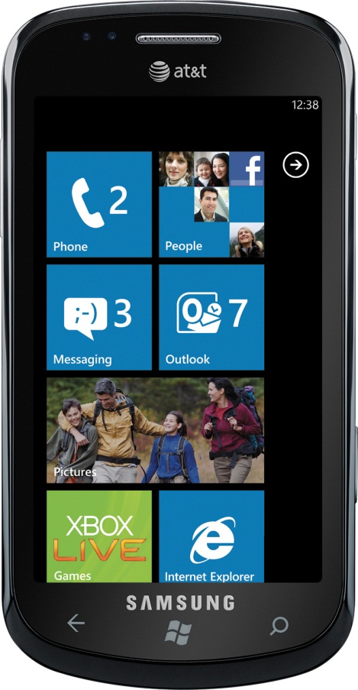

Notes:
Devices Devices Devices. Where do I even start.
Write once, everywhere? < sigh /> Maybe, but it still seems like a pipe dream to me.
Checking for user agents just doesn’t work anymore. We’re in the age of feature detection!!
Supporting it all could quite honestly be a full job. The only real way to solve the problem is with tools and techniques, such as Modernizr and Polyfilling.

Slide 13
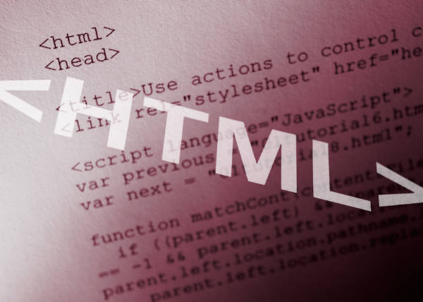
Notes:
But I think we can all agree, JavaScript is the language of the Web.
Frameworks like jQuery help make the DOM suck less
CoffeeScript helps cut some of the ceremony out of what we hate about JavaScript
Backbone.js and Kockout.js help us institute patterns in our UI
and node.js takes JavaScript out of the browser.

Slide 14

What does JavaScript mean to you?
Notes:
So what does JavaScript mean to you?
Do you consider yourself a Ninja?
Do you consider yourself a framework developer or consumer?
Or are you just passionate about JavaScript?
Regardless, with everything going on in the web space today, it’s a great time to reboot your JavaScript skills.
-----
Image taken from: http://www.flickr.com/photos/donkeyhotey/5666065982/sizes/l/in/photostream/

Slide 15
agenda
Stop slides and build something
3 features
XMLHttpRequest 2
Native JSON
Strict Mode
Keep it real
Leave with a few new things…
Notes:
Today I really just want to focus on three key areas. Some which are so bleeding edge there still in flux to others that are part of ECMAScript 5.
My goals is you walk out with a few new tools in your toolbox with a brief look into the future.

Slide 16

XMLHttpRequest
Notes:
First lets start talking about Coors. Opps, wrong CORS, but now you’re thirsty huh.

Slide 17

XHR
CORS - Cross Origin Resource Sharing
Version 2, in progress
More than just JSON
Easy server implementation
Notes:
Image taken from: http://farm5.static.flickr.com/4011/4225640715_1c81841a11_m.jpg

Slide 18

JSON
Notes:
Image taken from: http://blogs.sitepointstatic.com/images/tech/133-javascript-serialization.jpg

Slide 19
JSON
Native to the language
Supports (de)serilization
Manipulate serialization process
Very easy to polyfill

Slide 20

“use strict”
Notes:
Image taken from: http://www.recognitionheroes.com/wp-content/uploads/2011/01/Teacher-with-Discipline-Written-on-Board-for-Blog.jpg

Slide 21
“use strict”
“Converting mistakes into errors” ₁
Enable the “good parts”
Remove the mashup problem
opt-in mode
Backwards compatible ( sorta )
Notes:
1. Chris Heilmann, “ECMAScript 5 strict mode in Firefox 4”, Online posting dated January 25, 2011, http://hacks.mozilla.org/2011/01/ecmascript-5-strict-mode-in-firefox-4/, retrieved 8/31/2011

Slide 22

code time

Slide 23

what just happened?
XMLHttpRequest
Total bleeding edge
Makes CORS easy
JSON
Now native
Backwards Compatibility
Strict Mode
Happy places, while preparing for the future
Don’t be too strict

Slide 24
HTML5 in Web Technologies
Tooling
Visual Studio 2010
WebMatrix
Frameworks
Modernizr, yepnope
CoffeeScript
node.js
Knockout.js or Backbone.js

Slide 25




Things You Need to Learn
(Re)Learn JavaScript
Learn A JavaScript Framework
Learn the dev tools in all of the browsers
Notes:
JavaScript Patterns - http://oreilly.com/catalog/9780596806767/
JavaScript The Good Parts - http://oreilly.com/catalog/9780596517748
Eloquent JavaScript - http://eloquentjavascript.net/
jQuery in Action - http://www.manning.com/bibeault/

Slide 26
resources
BeautyOfTheWeb.com
IETestDrive.com
IE Test Center
IE10 Platform Preview Download
WebMatrix Download

Slide 27

link bundle
http://on.csell.net/sdcj

Slide 28
demo source
http://github.com/csell5/demos

Slide 29


August 13th – 15th 2012
Kalahari Resort, Wisconsin Dells, WI

Slide 30
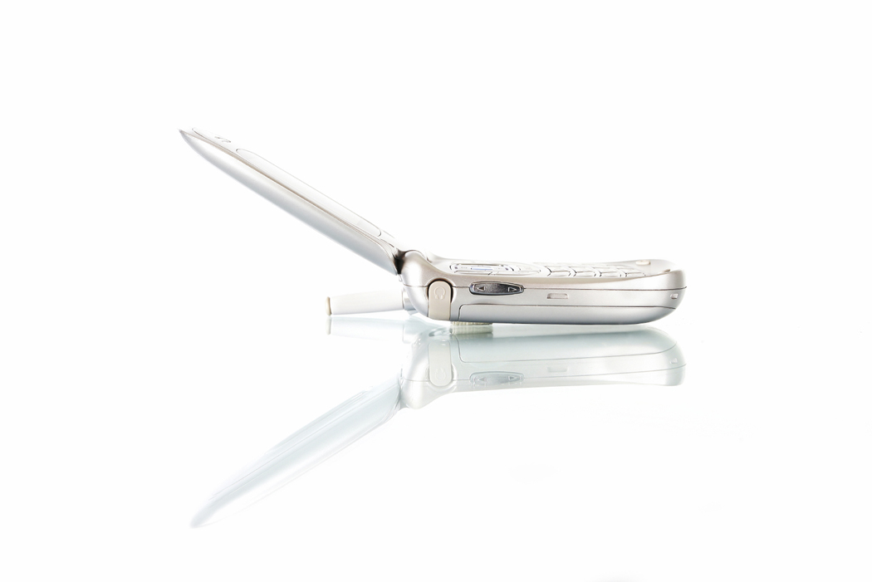
contact info
TXT CSELL5 TO 50500

Slide 31

Let’s Make Awesome Web Together

Slide 33

© 2011 Microsoft Corporation. All rights reserved. Microsoft, Windows, Windows Vista and other product names are or may be registered trademarks and/or trademarks in the U.S. and/or other countries.
The information herein is for informational purposes only and represents the current view of Microsoft Corporation as of the date of this presentation. Because Microsoft must respond to changing market conditions, it should not be interpreted to be a commitment on the part of Microsoft, and Microsoft cannot guarantee the accuracy of any information provided after the date of this presentation. MICROSOFT MAKES NO WARRANTIES, EXPRESS, IMPLIED OR STATUTORY, AS TO THE INFORMATION IN THIS PRESENTATION.

